Slide 1
Simulations of H-Ni(111) Tunnelling Rate

Slide 2
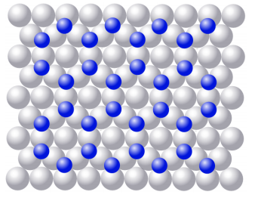
The Problem
Find the tunnelling rate of Hydrogen on the surface of Nickel
Close-Packed Plane structure leads to two types of hydrogen sites (FCC and HCP) arranged in a honeycomb structure[1]

Slide 3
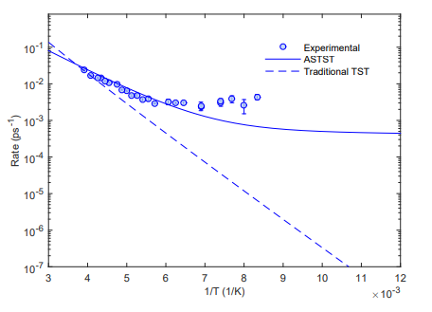
The Problem
Find the tunnelling rate of Hydrogen on the surface of Nickel
Actual State Transition State Theory (ASTST) previously used
to find tunnelling rates, but could not predict low temperature behaviour[1]

Slide 4
The Problem
ASTST only deals with coherent tunnelling
At low temperatures we enter the decoherent regime, when
interactions between the hydrogen and the free electron gas become relevant
Electrons act as a heatbath, allow the hydrogen to gain the energy required to tunnel into HCP.

Slide 5
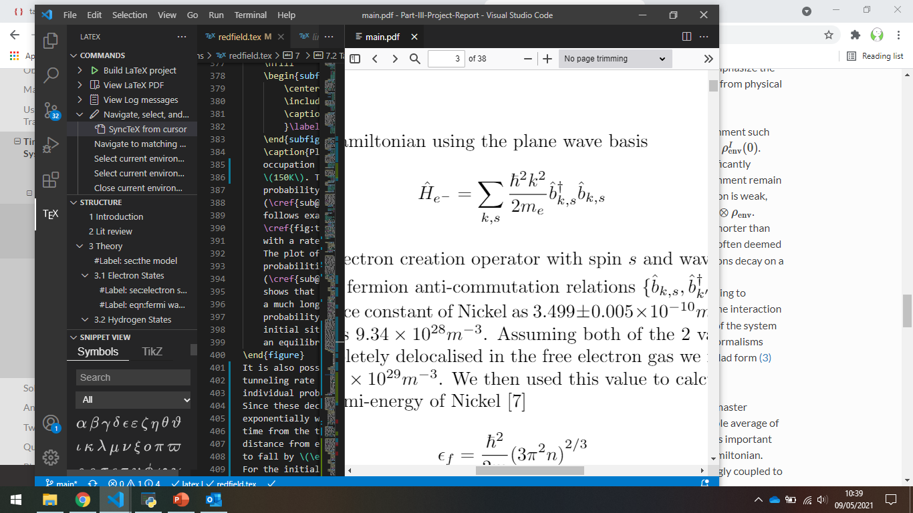
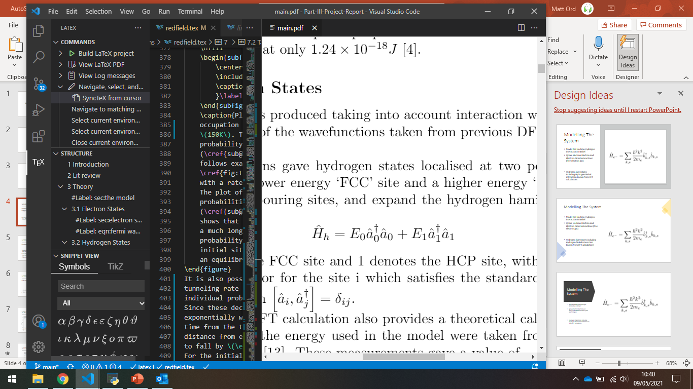
Modelling The System
Model the Electron-Hydrogen interaction in Nickel
Ignore Electron-Electron and Electron-Nickel interactions (free electron gas)
Hydrogen Eigenstates including Hydrogen-Nickel interaction known from DFT calculations

Slide 6
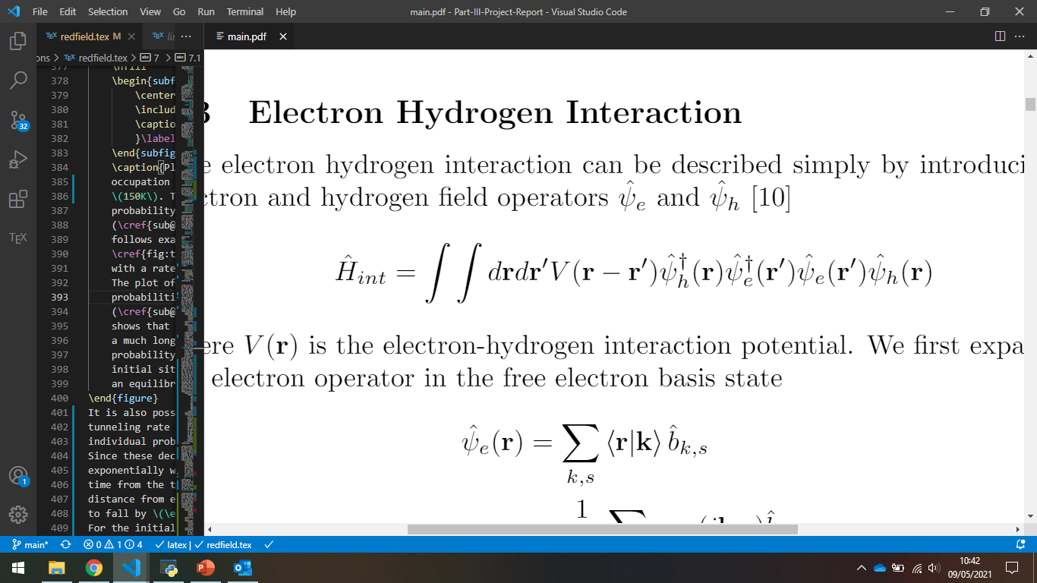
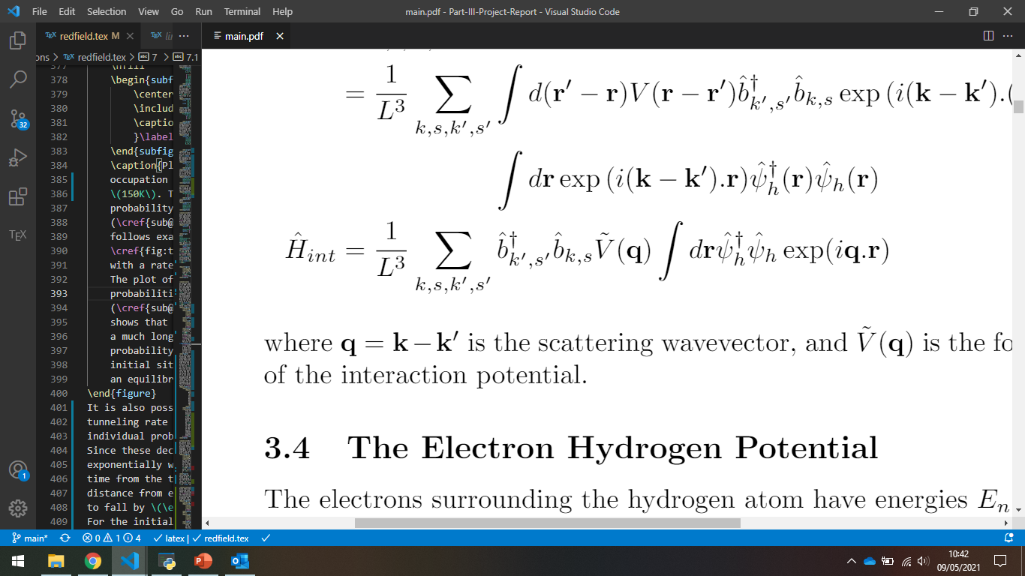
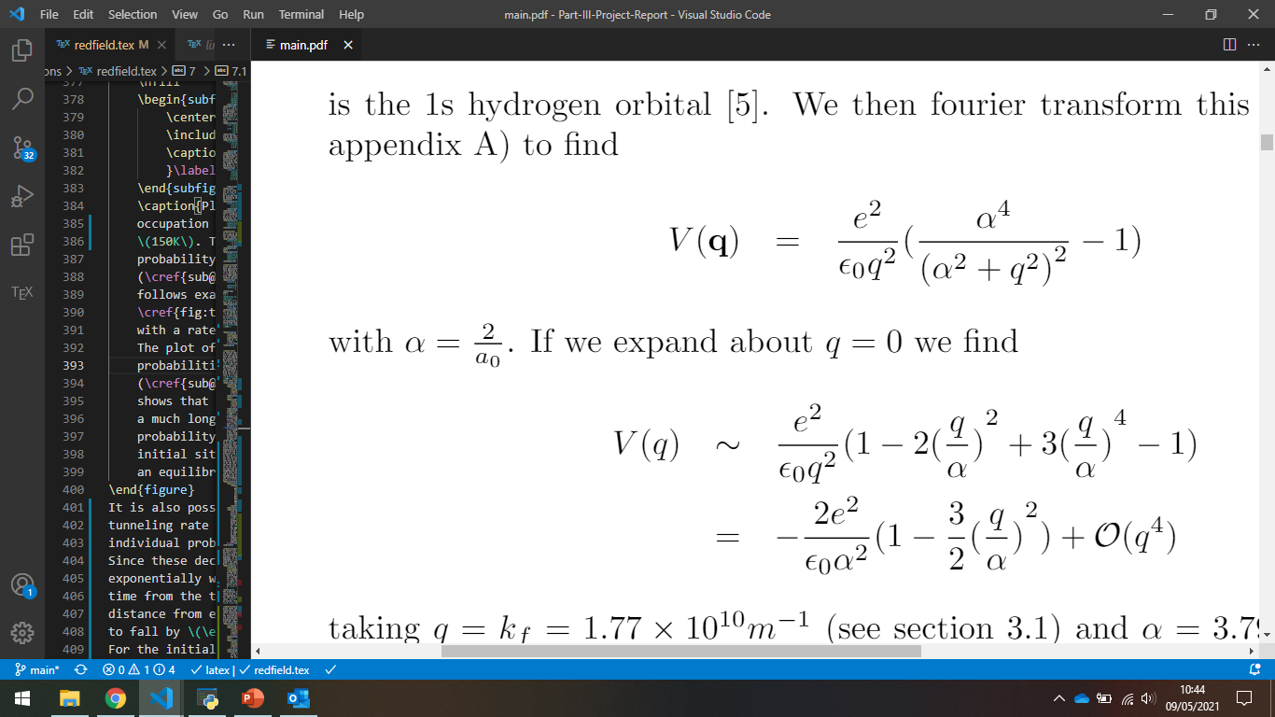
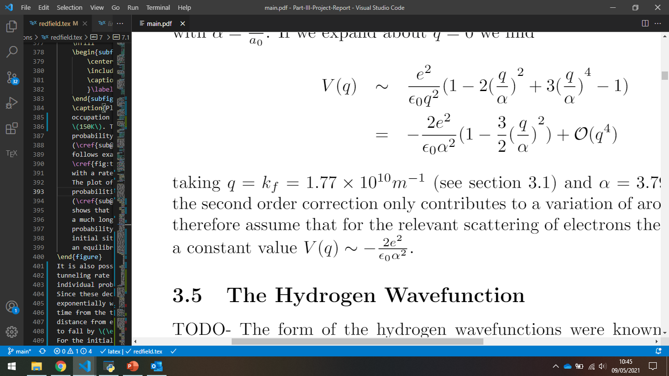
Modelling The System
Interact through the coulomb interaction
where

Slide 7
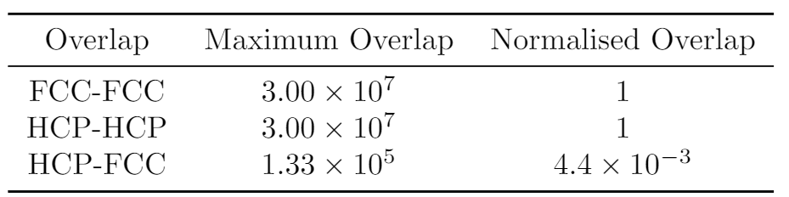
Modelling The System
We find the `overlap integral’ from DFT calculations, and again
assume q independent

Slide 8
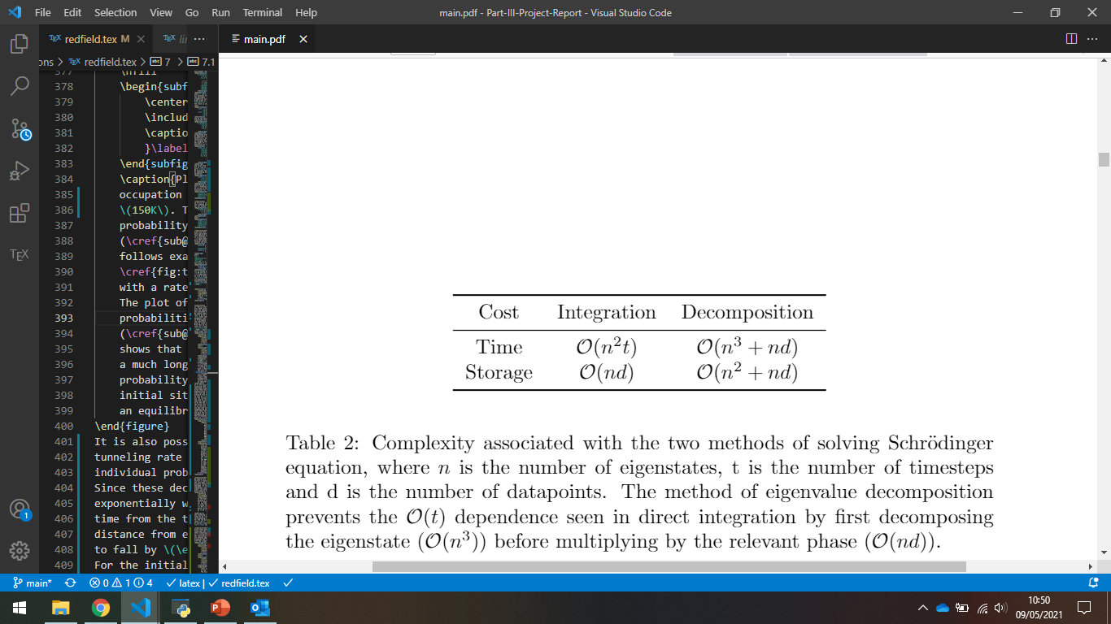
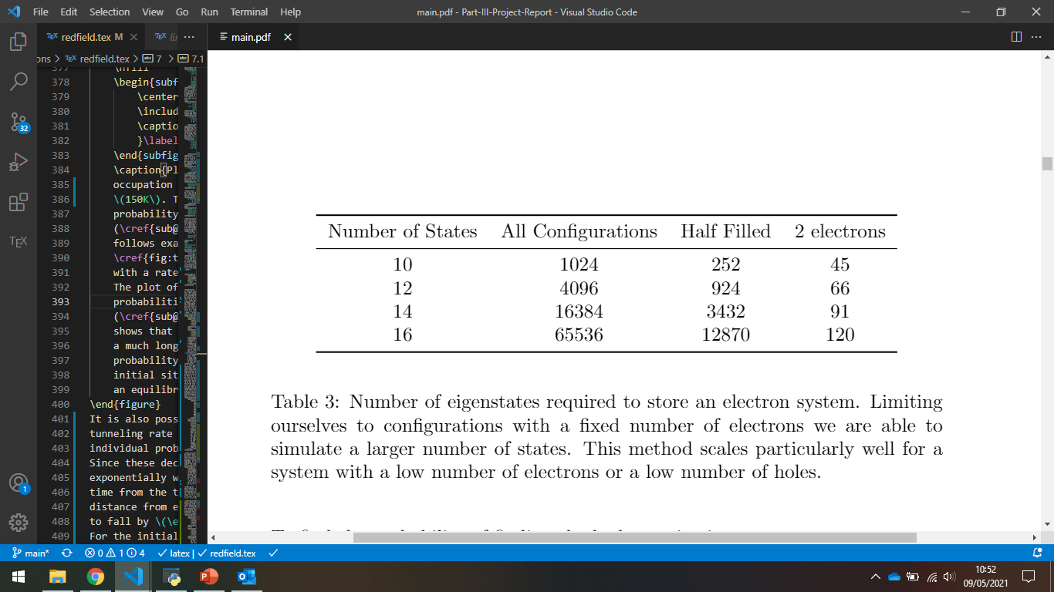
Direct Simulation
Choose the method of eigenvalue decomposition
Constant N, scales particularly well with a small number of
electrons

Slide 9
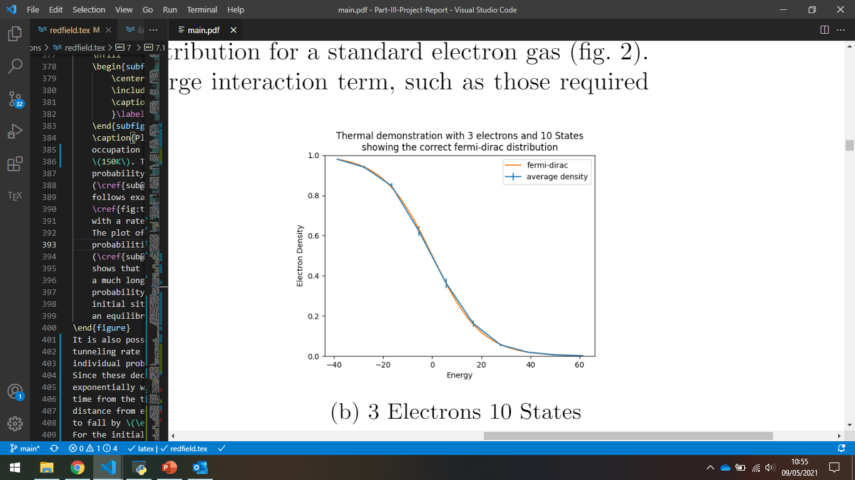
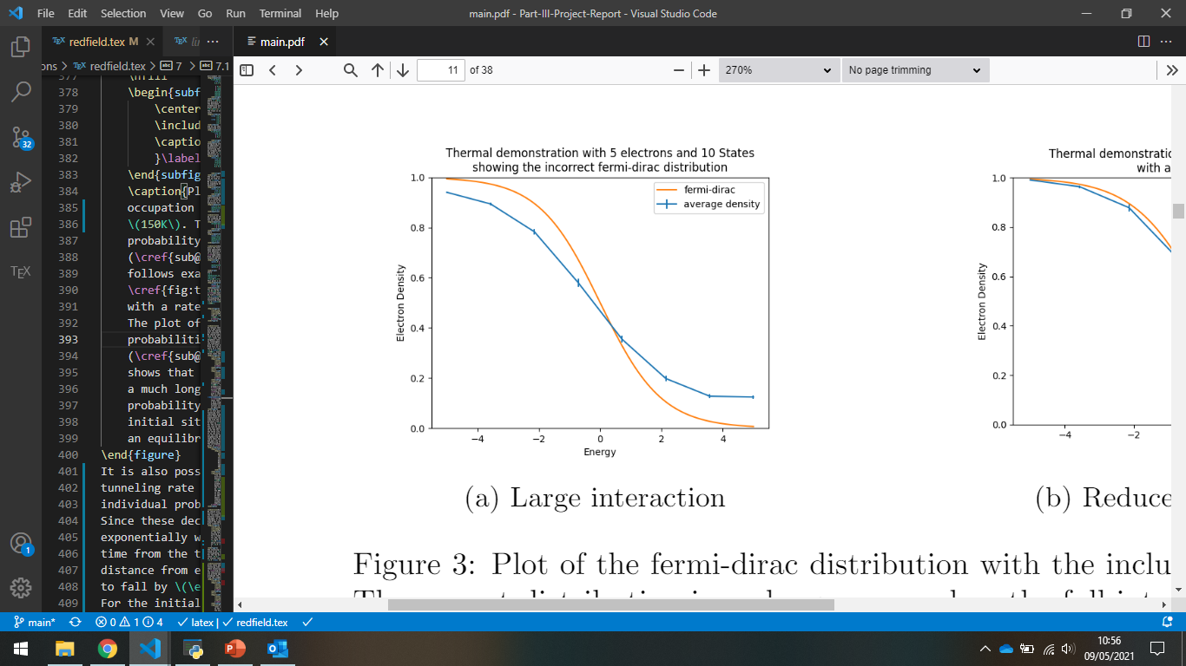
Direct Simulation
Choose electrons from a fermi-dirac distribution – works well for a small interaction
Choose energies with a random offset to prevent rabi oscillations

Slide 10
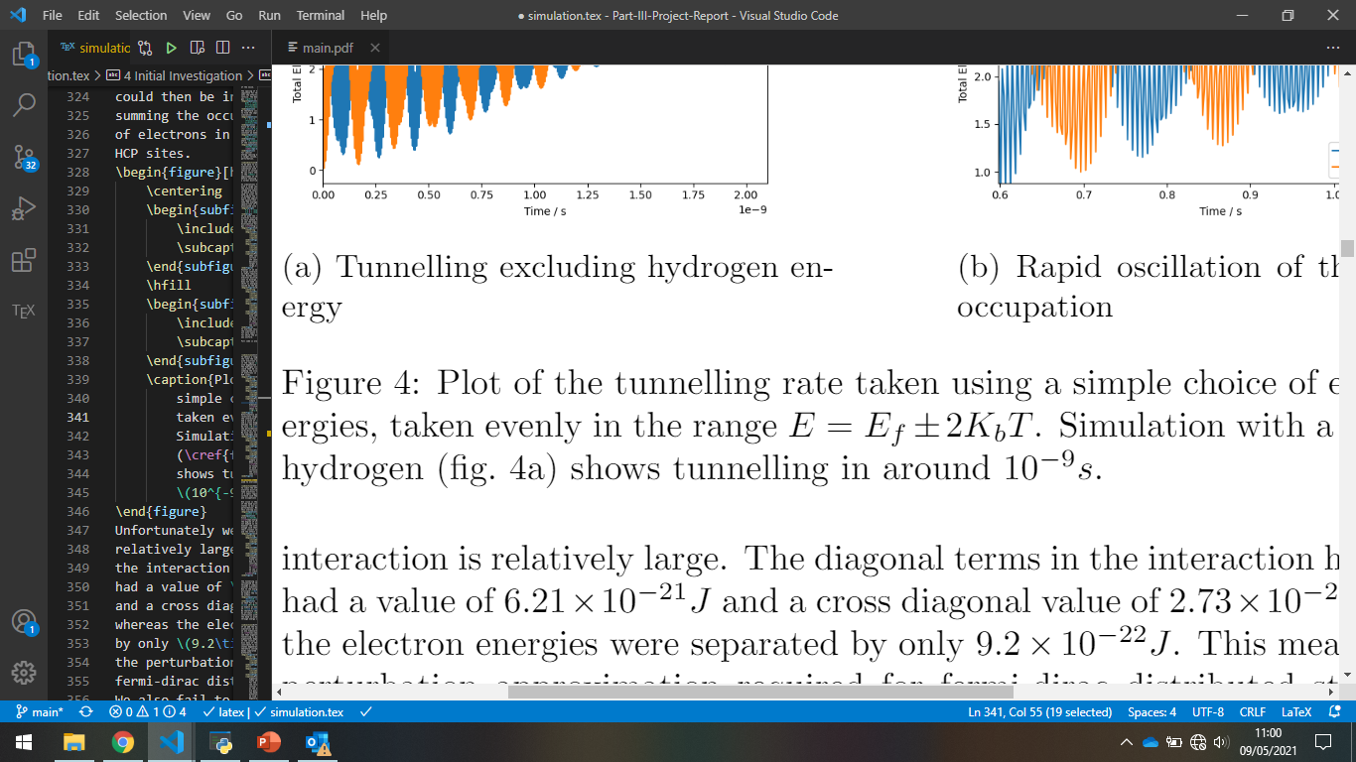
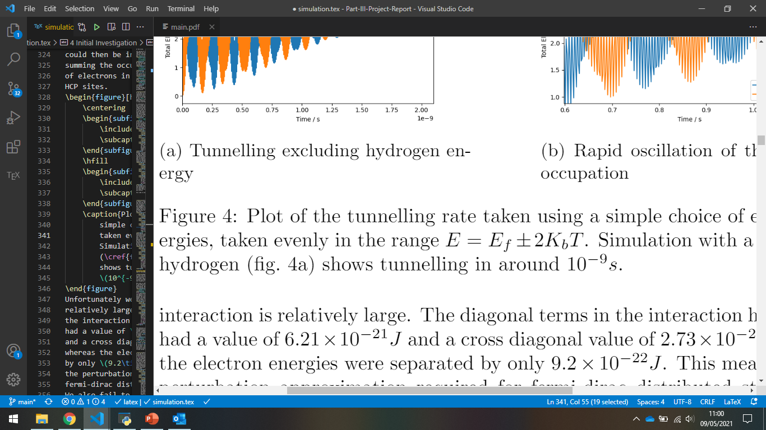
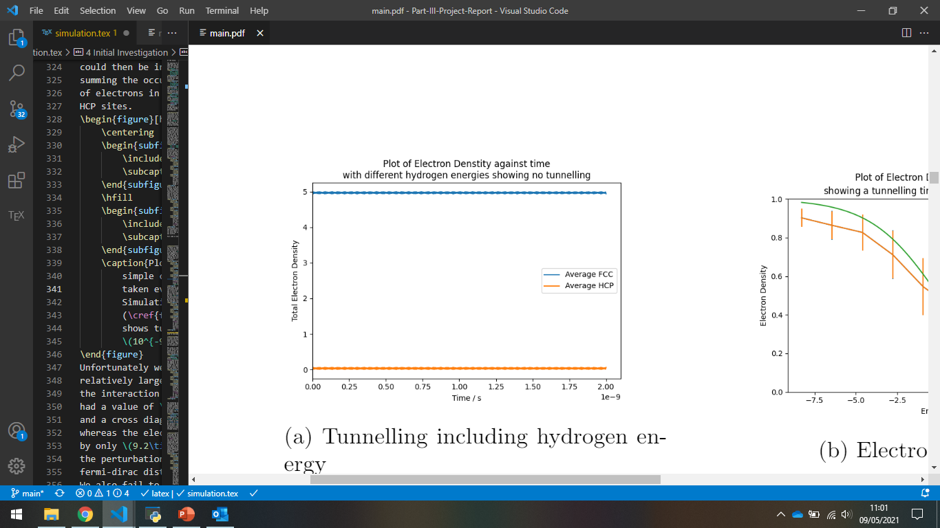
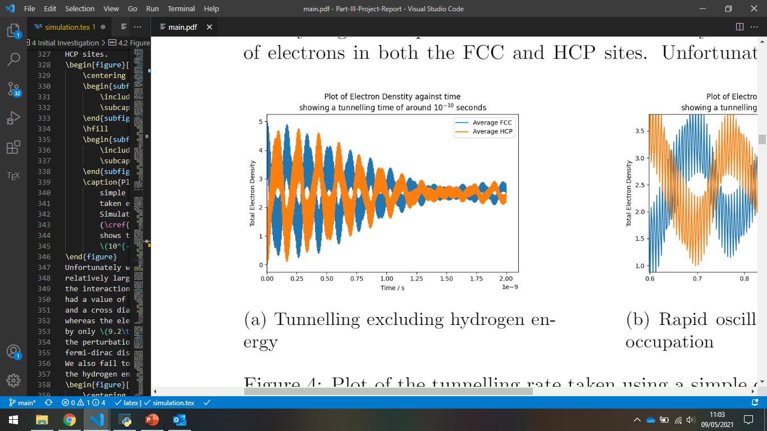
Simple Approach
Choose energies over the range
Gives a tunnelling time of No tunnelling if we add hydrogen energies, incorrect fermi-dirac distribution.

Slide 11
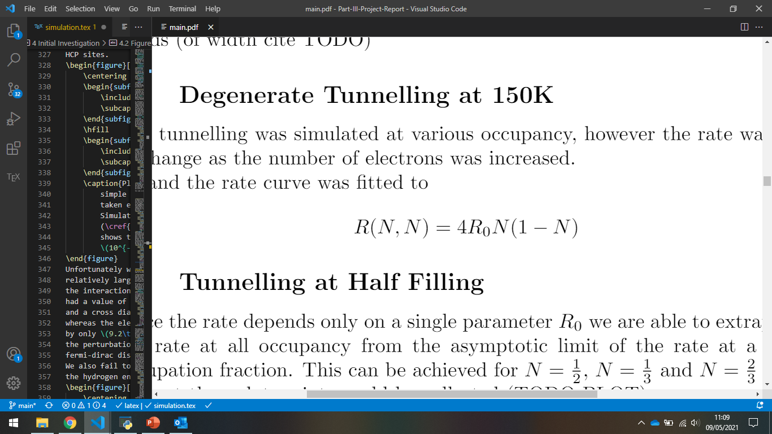
Improved Approach
Choose energies in a small band- correct fermi-dirac distribution
Must ignore hydrogen energies to see tunnelling
Data fitted to , we use the half filled occupation to find .

Slide 12
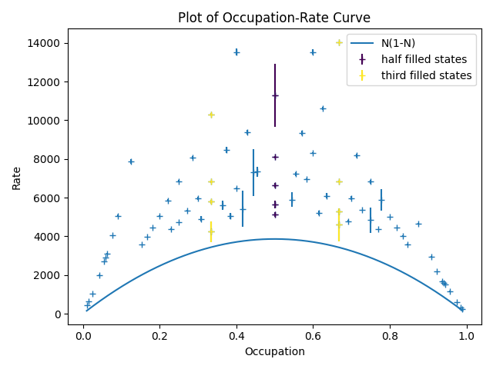
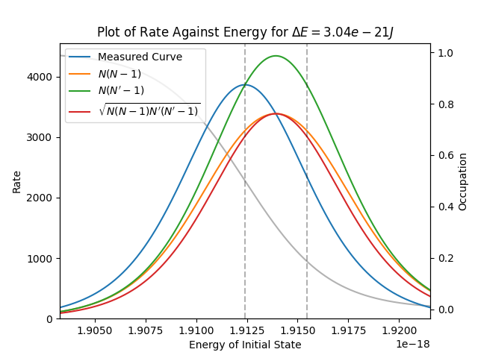
Improved Approach

Slide 13
Improved Approach
Able to integrate over the energy-rate curve to find a total rate
Multiply by a factor of 2 for the spin, and a factor of 3 for the neighbouring sites.
Tunnelling actually causes a transition from an upper to a lower energy, and we must correct for this behaviour.
The data at 150K can then be used to find a rate at all temperatures

Slide 14
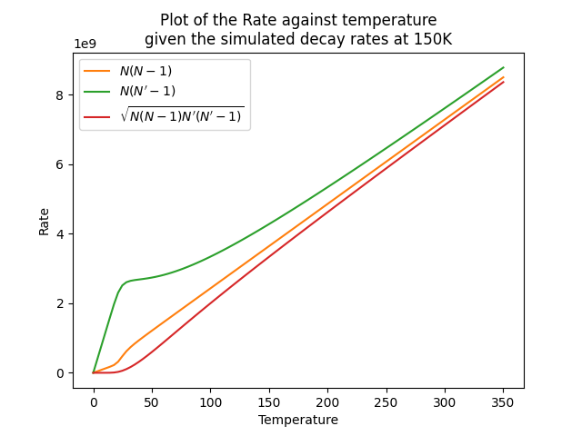
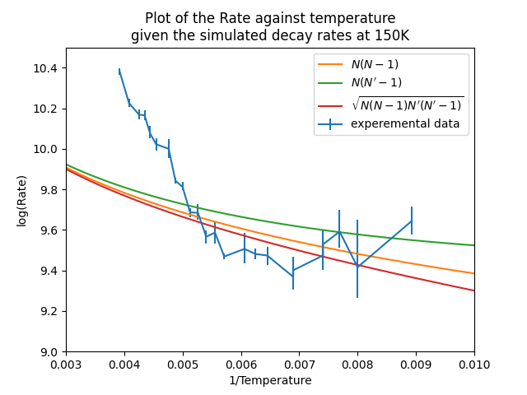
Comparison With Experiment

Slide 15
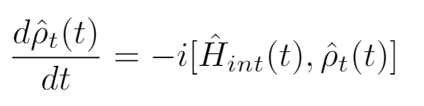
Lindblad Equation
Starting from the Von-Neumann Equation in the interaction picture
General Idea is to expand equation of motion to second order and take the trace over the environment
Assume the density matrix is separable at t=0, the Born approximation and the Markovian approximation.
We also apply the rotating wave approximation.[2]

Slide 16
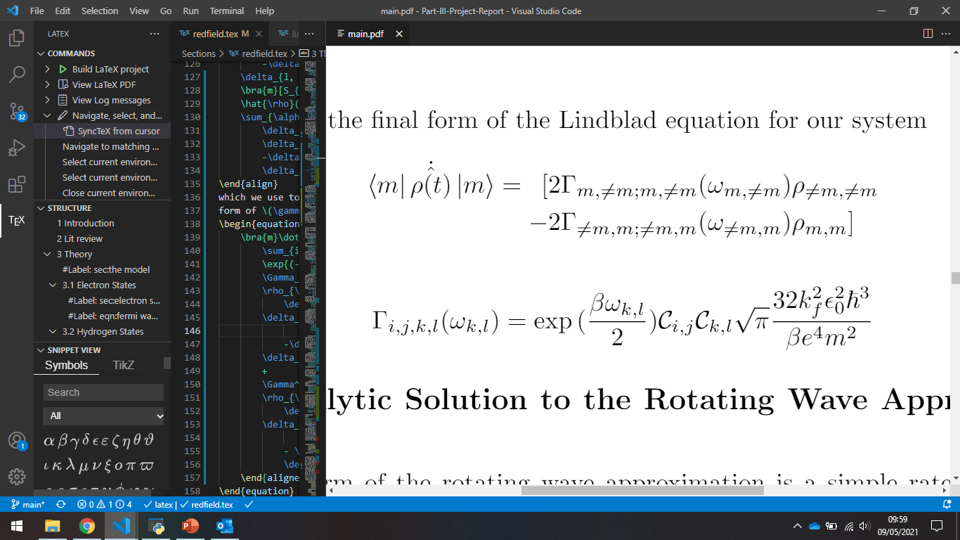
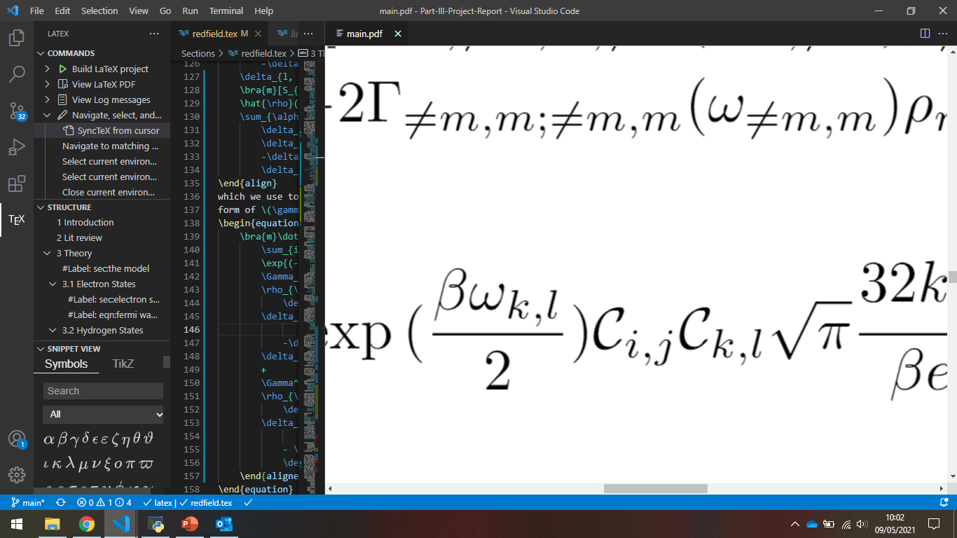
Lindblad Equation
We arrive at the following result
is the hydrogen overlap
is the energy difference between the two sites

Slide 17
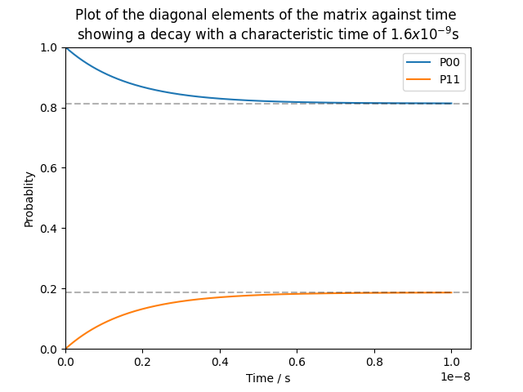
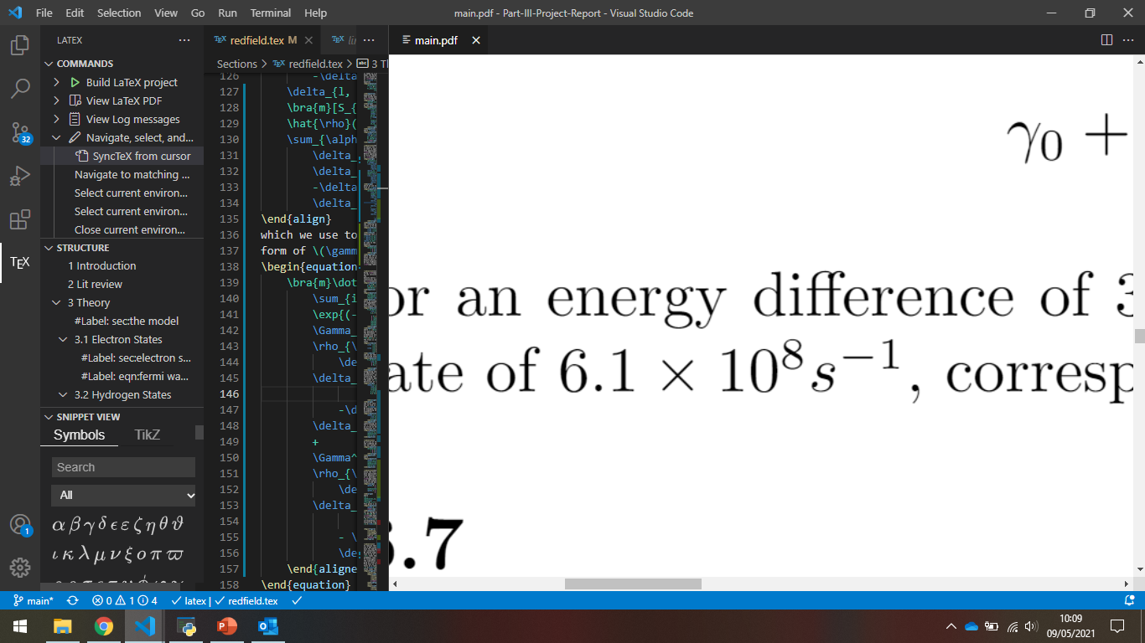
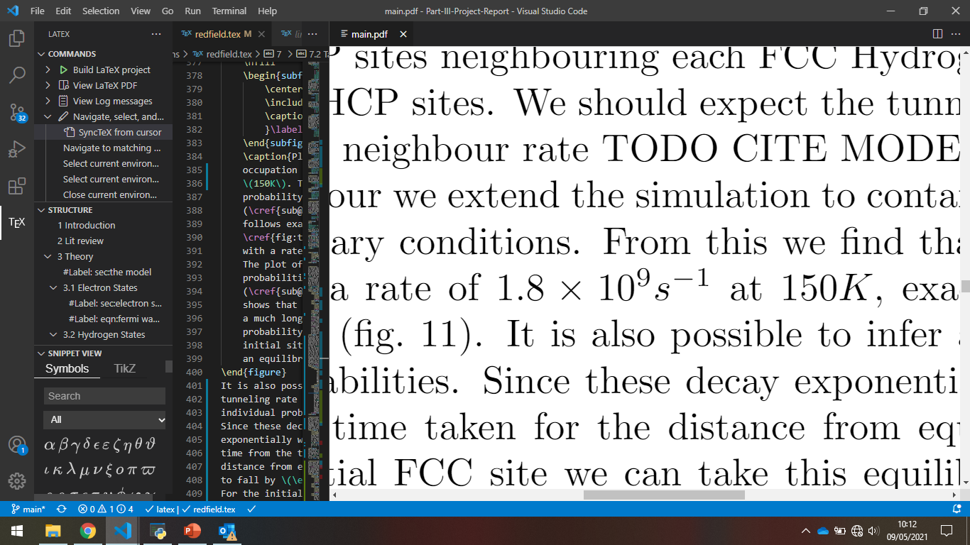
Single Site Behaviour
Can be solved analytically – a simple exponential decay
Single neighbour rate 150K
3 Neighbour rate 150K

Slide 18
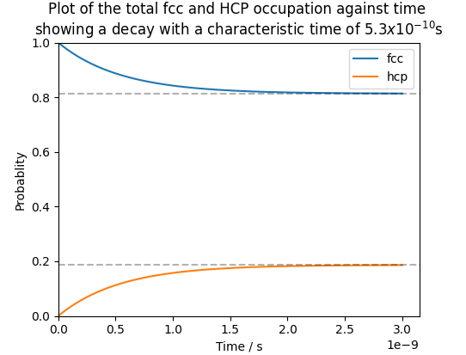
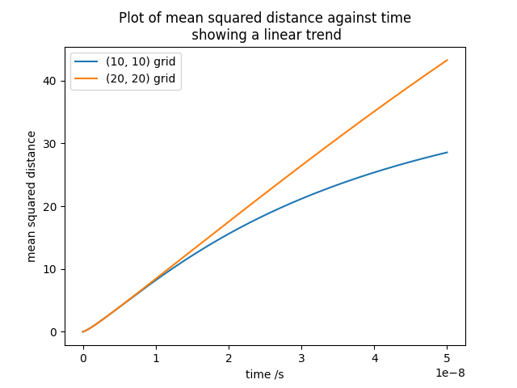
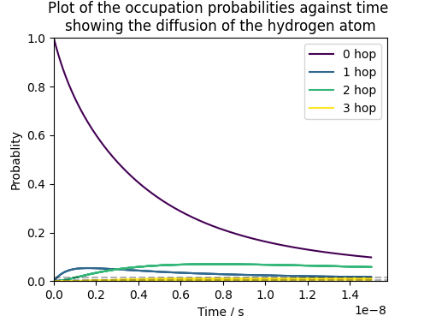
Multiple Site Behaviour

Slide 19
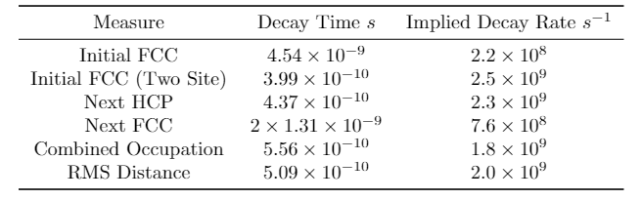
Multiple Site Behaviour

Slide 20
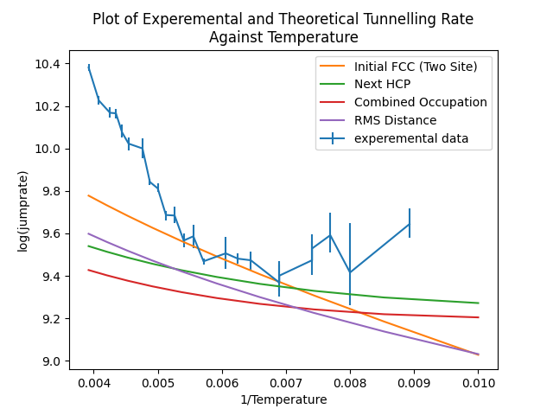
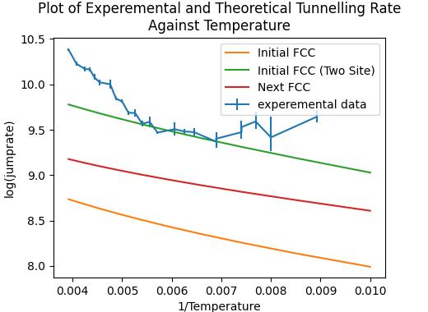
Comparison With Experiment

Slide 21
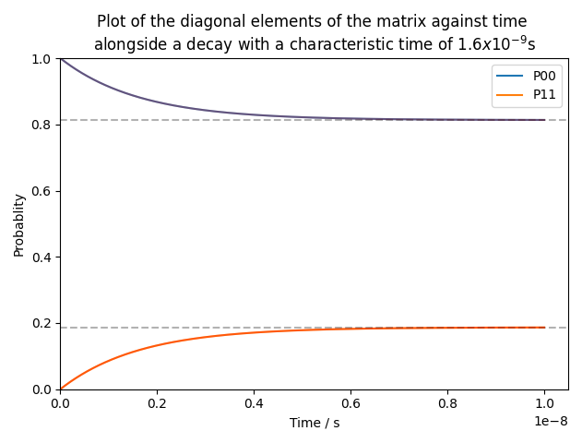
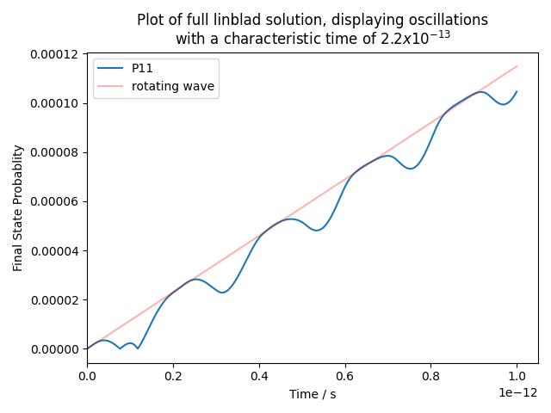
Comparison With Redfield

Slide 22
References
[1] Jianding Zhu. “Study of quantum effects in adsorbate diffusion”. PhD thesis. Churchill College, University of Cambridge, Apr. 2015
[2] Daniel Manzano. “A short introduction to the Lindblad master equation”. In: AIP Advances10.2 (Feb. 2020)

